Slide 1
Using Convolutional Networks and Satellite Imagery to Identify Patterns in Urban Environments at a Large Scale
1
NAME: Parom Guha Neogi ID: 20101562 GROUP: 06
Student Tutor: EHSANUR RAHMAN RHYTHM
Research Assistant: Md. Sabbir Hossain

Slide 2
Introduction
2
Convolutional Neural Networks (CNNs) have been widely used for video classification, particularly for action recognition tasks, and have shown excellent performance. Deep learning models have shown great promise for video classification tasks and have the potential to significantly impact various fields, including security, healthcare, and entertainment.

Slide 3
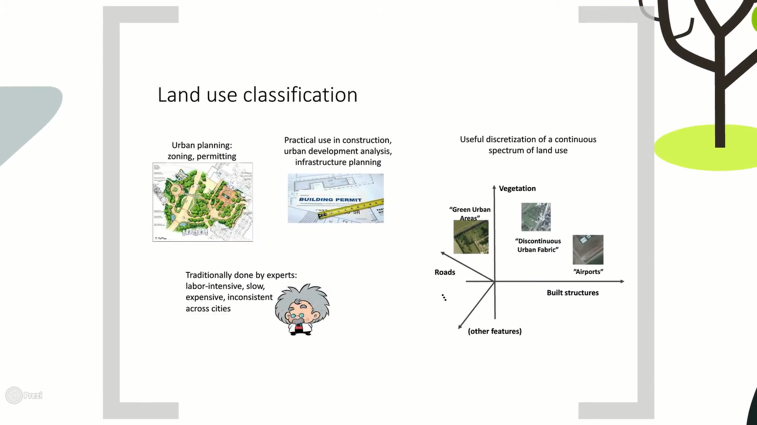
3

Slide 4
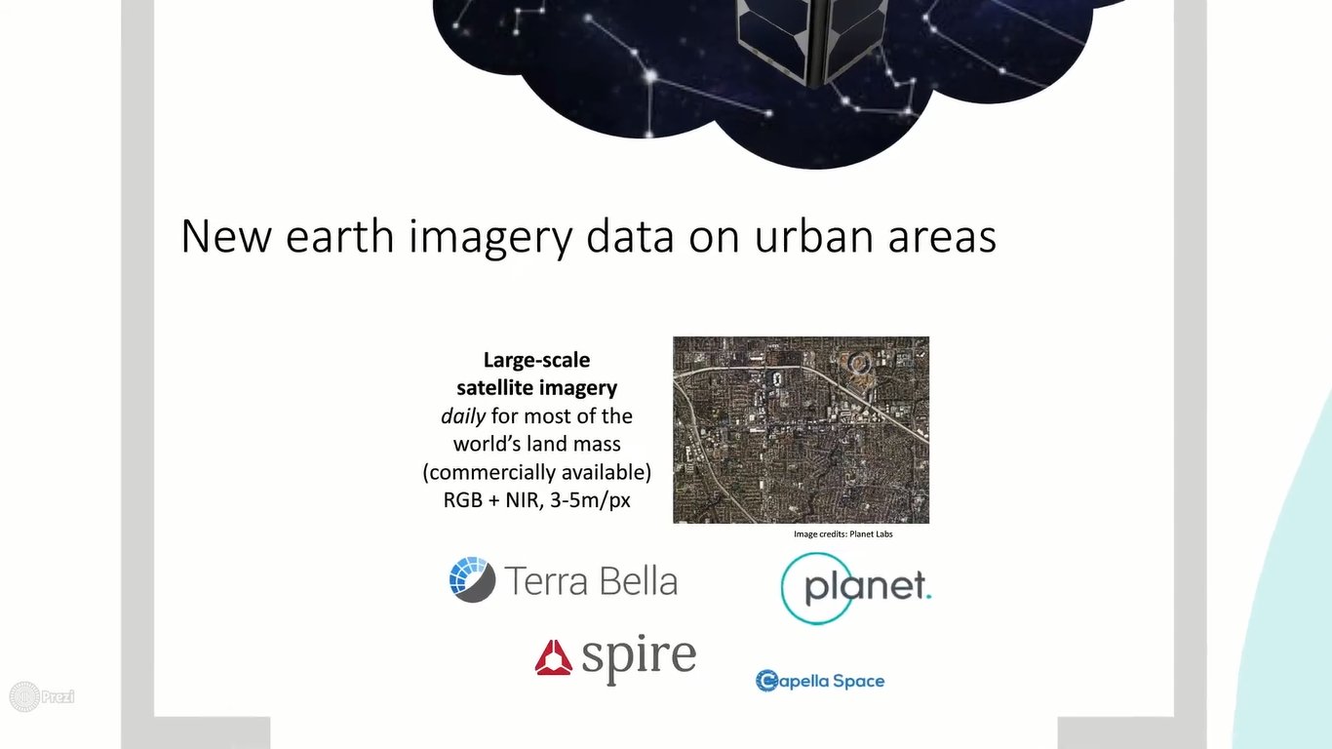
Why Video Classification Matters?
4

Slide 5
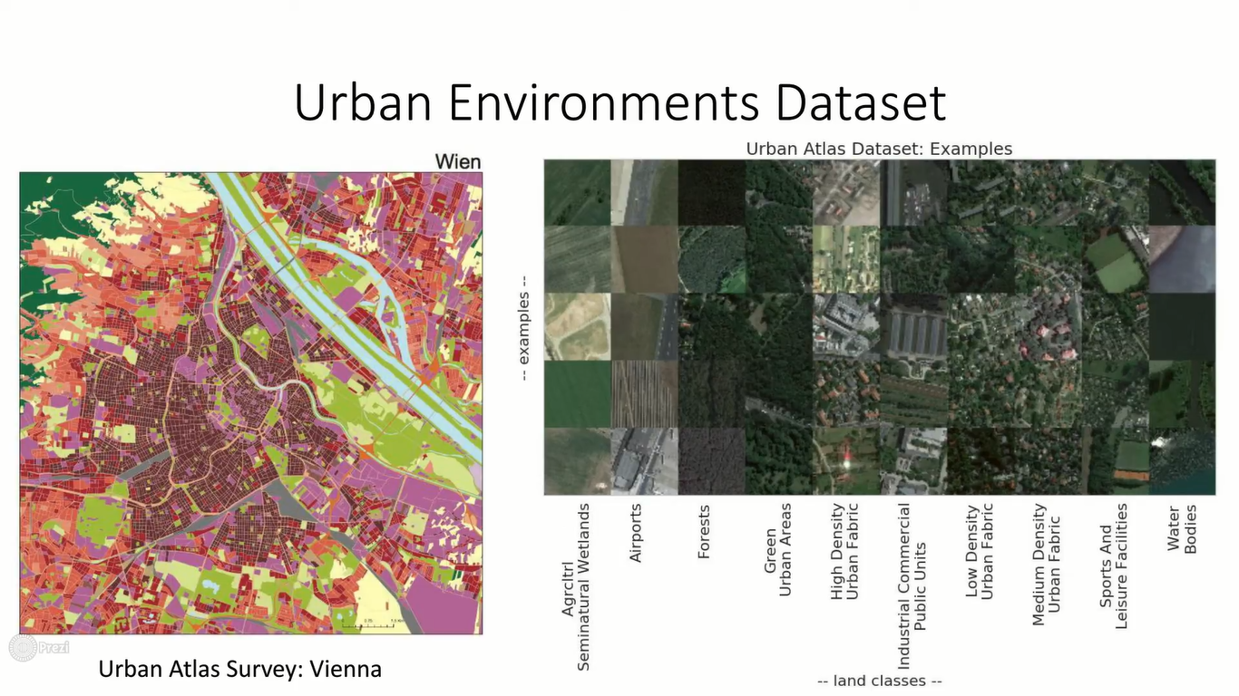
5

Slide 6
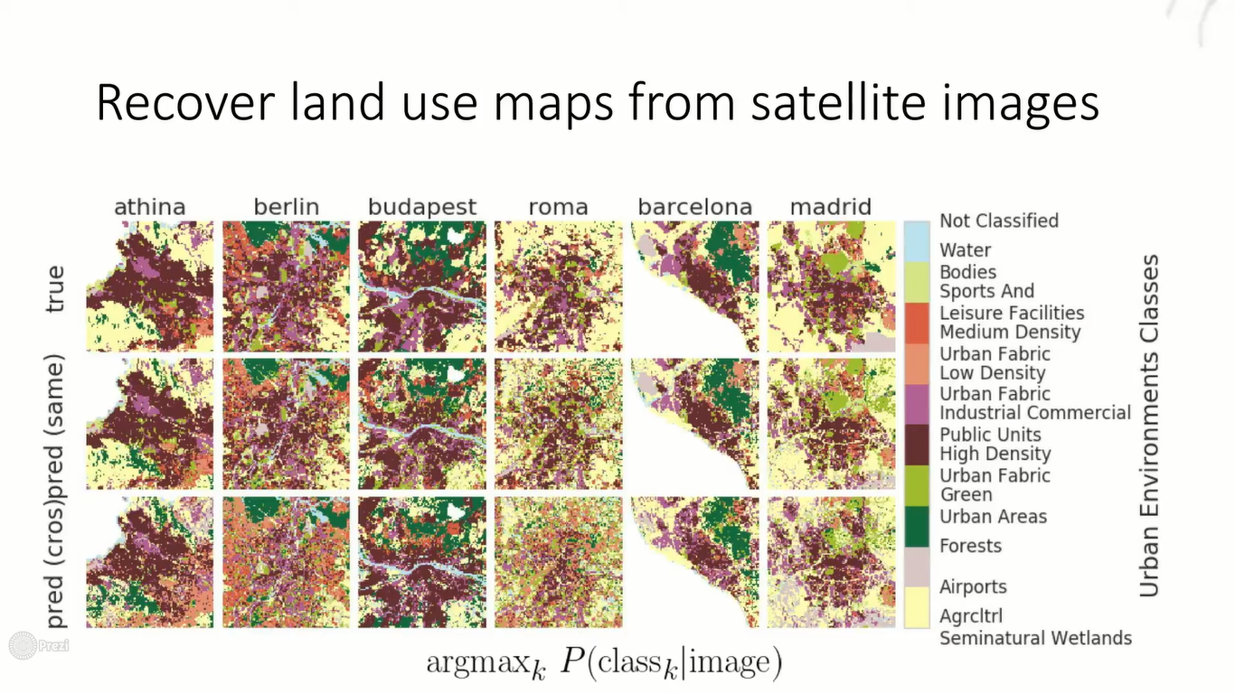
6

Slide 7
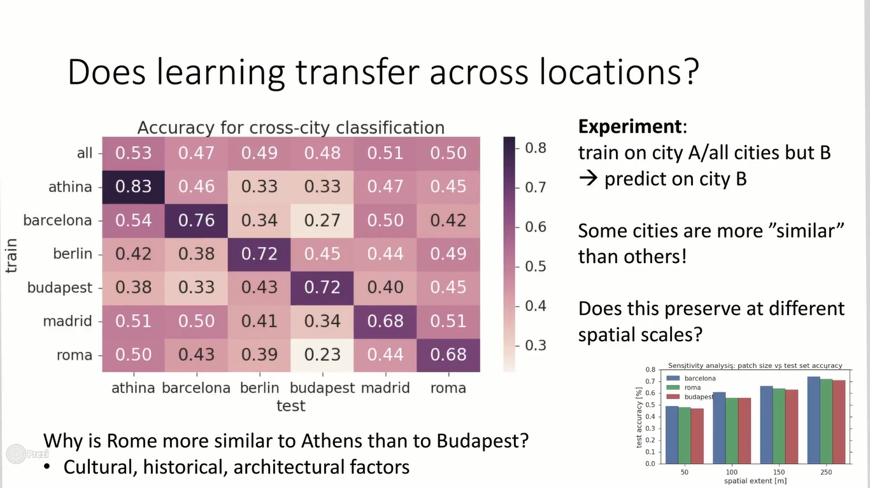
7

Slide 8
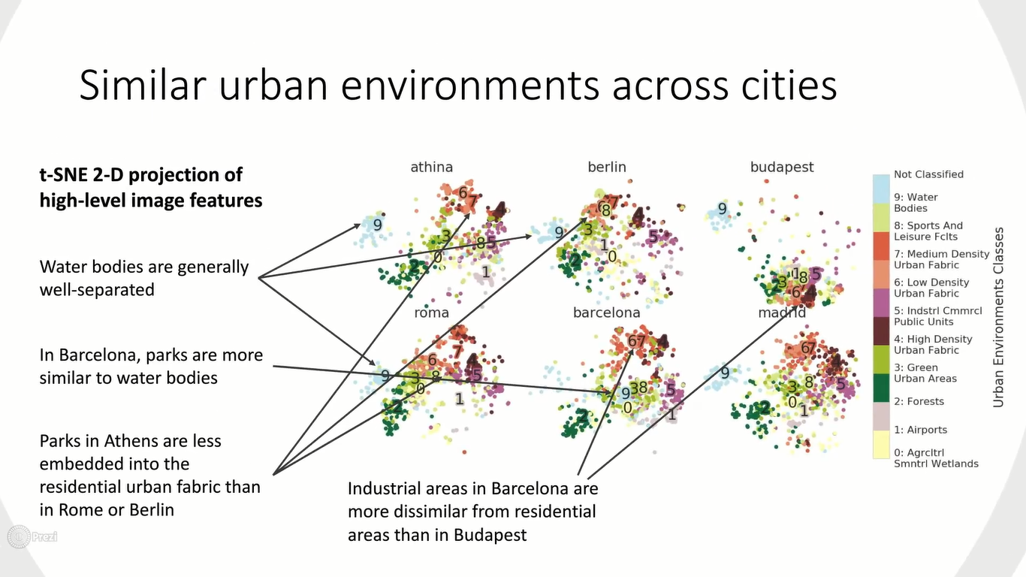
8

Slide 9


